Slide 1
QA & 近況
Statistical Mechanics of Competitive Resource Allocation using Agent-based Model 2015
Modeling Market Mechanism with Evolutionary Games 1998

Slide 2
結果
1.MG-Open system(with market maker)
Equation- delta wealth ok
Consist of 3 parts
i. Total cash flow with market maker Q:how to analyze the equation P.16
ii. Raise/Decay of assert depends on initial holding position ok
iii. The present value of total assert flow with market maker ok
2.MG-Close system Wealth Analysis
i. Wealth is not a conserve quantity ok
3.Why the $2 is better than MG
background reason ok
MG-equation Q:how to analyze the equation P.18
$2-equation
Raise/Decay of assert depends on initial holding position ok
Delta C Q:how to analyze the equation P.18
分析
需要了解MG在相圖中實際代表的意義
0.Global efficiency ok P.3
1.Herding (crowding) ok P.4
2.Coin toss limit
3.臨界點
4.frozen
論文
目前寫到原理
考慮 why is there a critical point的數學論述較完整(主要)
且reduced set of strategy 不同s臨界點不同(補充)
Q : why is there a critical point P.4,P6,P7

Slide 3
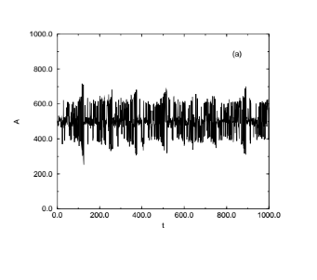
Global efficiency
1.極端情況
Set N =101
較大的漲落，意即當局得分的人數較少，將此視為系統效率較低
反過來說
較小的漲落，意即當局得分的人數較多，將此視為系統效率較高
結論
In minority mechanism, no one get “win”
將整個賽局視為一個社會情況，實際作為上 沒有人得分

Slide 4
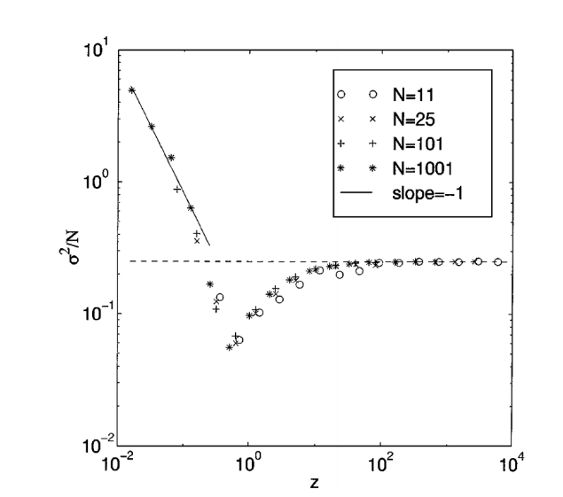
Phase diagram
For fix N P<<N
P較小時，agent分析能力較差，具體展現為
P<<N時，即經濟情況總數較少，此時從策略空間(個數為2^{P})張策略表中挑出N*S張策略表，此時容易挑到重複的策略表，選擇時經常發生撞車現象(例如這一輪買得贏了，因策略表相同倍加到分，導致下一回合都採取相同的動作，因此造成漲落常常大起大落，也被稱為羊群效應
Key word
(herding effect/crowd effect/策略空間擁擠)
討論
我覺得這部分物理概念蠻完整的，可以放入論文
討論
我覺得這部分物理概念還可，不過缺少一點說服力，希望補足一些數學
(可從reduced set of strategy space)
For fix N P>>N
P較大時，agent分析能力較好，然而
P>>N時，經濟情況總數非常多，此時從策略空間(個數為2^{P})張策略表中挑出N*S張策略表，此時幾乎不會挑到同樣的策略表，策略表之間彼此完全沒有關聯性，因此玩家在選擇買賣時看起來幾乎是隨機的，達到擲硬幣極限
Key word (coin-toss-limit/策略空間稀疏)
討論
物理概念太模糊
希望從why there is a critical point的數學中得到完整的看法
For fix N
當P增加時，agent分析能力增加，使得漲落變小，社會系統效率變好，使漲落量值小於random
For fix N
在過了臨界點之後，agent分析能力變得太好
聰明反被聰明誤，使得猜錯的機會增加，也使漲落增加

Slide 5
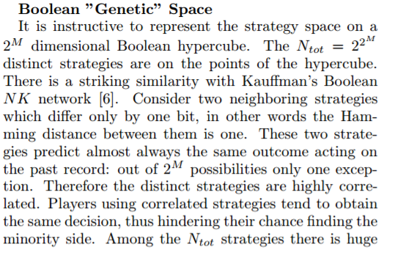
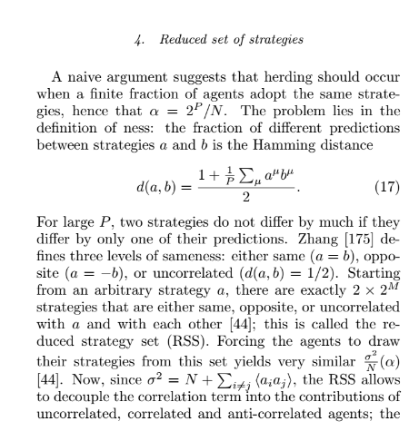
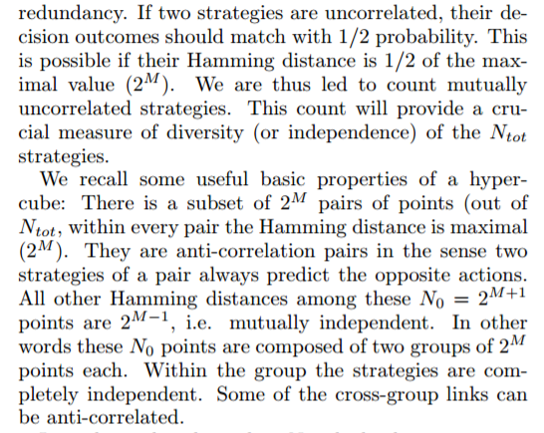
Reduced set of strategy space
如何理解
Uncorrelated的steategy總共有

Slide 6

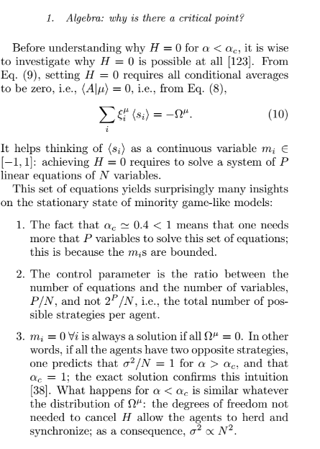
老師，solve a system of P linear equations of N variables這裡看不太懂?

Slide 8
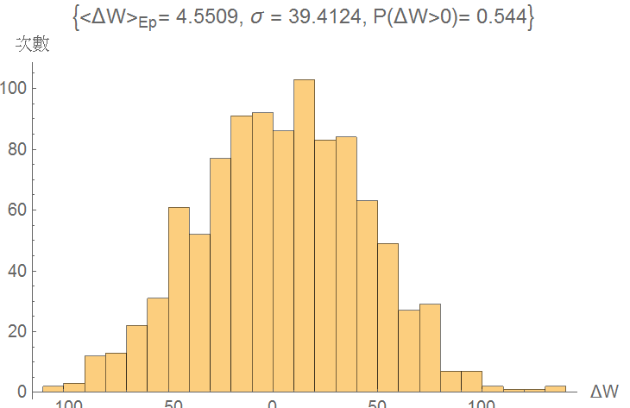
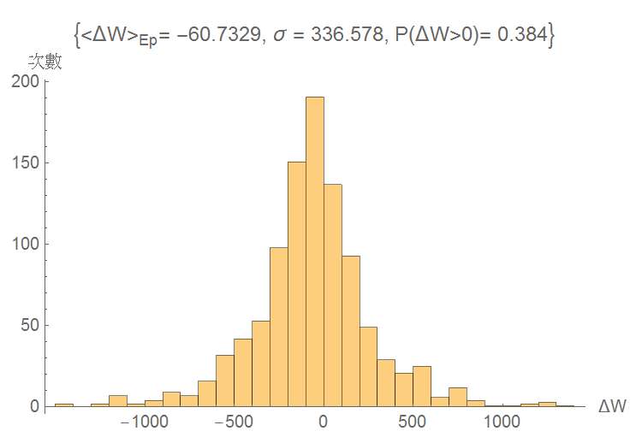
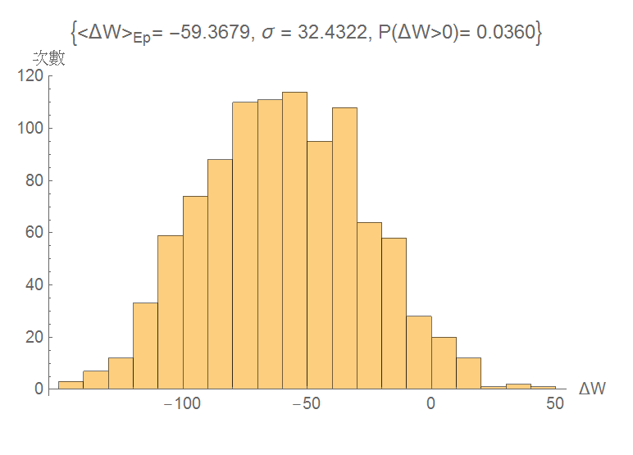
Wealth m=3 realization 1000

Slide 9
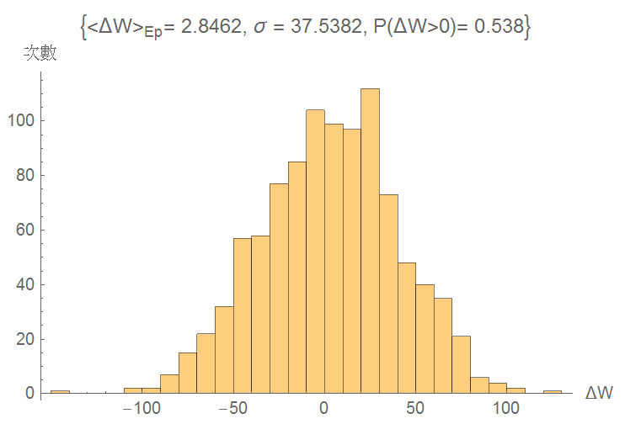
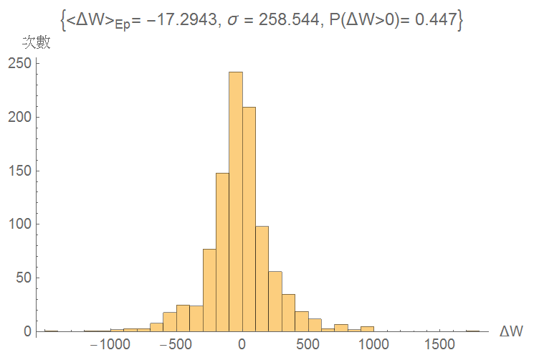
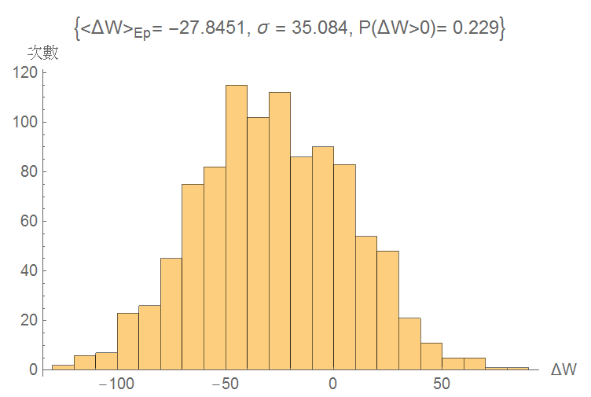
Wealth m=4 realization 1000

Slide 10
The background
1. See all agents as a group
The holding position of all agent
In micro sight
After match
Exceed demand trade with market maker

Slide 11
The background
假設沒有借出股票的行為，holding position恆正
則系統中全部agent在t,t-1財富量變化完全受到價格差的影響，擁有的股票數則可視為影響的權重
單純討論t,t-1時刻的分別
1.價格漲時，財富量必增加
2.價格跌時，財富量必減少

Slide 12
Open system → Close system
Exceed demand, trade with market maker !
Consider a close market, agent only trade with each other
1.Exceed demand would NOT be get.
2.But exceed demand is about sent order, will affect on price
Mathematically, B.C is given.
For all time step t

Slide 13
Close system The background 股市市值蒸發及膨漲
1.The wealth of system/agent is NOT a conserve quantity.(but the cash is)
2.The wealth decay/rise immediately with price fluctuation.

Slide 14
Open system The background for all time t
Delta wealth of system consist of 3 part
1.Total cash flow with market maker
2.Raise/Decay of assert depends on initial holding position
3.The present value of total assert flow with market maker

Slide 15
Analysis of open system
Second term is purely raise/decay of the initial assert which the same in close system
Interestingly, first term and third term are a pair of non-risky assert and risky assert due to the total extra trade with market maker.
3.Since p(T) behave randomly around p(0) under minority mechanism, the raise/decay of assert also behave randomly with initial amount of assert.
4.Although is also around 0. But the value will distribute a range.
-n_{M}(T) | p(T) | -n_{M}(T) p(T)
-40 | 6.01 | -240.7
16 | 11.5 | 185.4
32 | 13.1 | 421.8
12 | 11.1 | 134.3
12 | 11.1 | 134.3

Slide 16
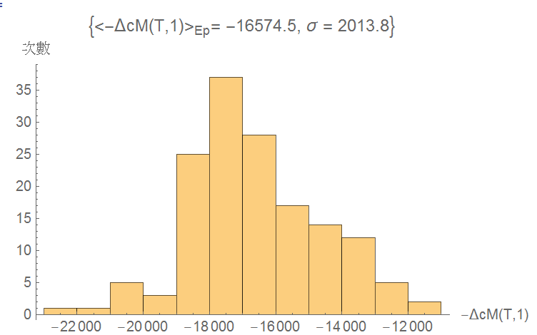
Analysis of open system
5.Interestingly, always be negative which means all the agent lose money to market maker
-ΔC_{M}(T,1)
-18527
-15258
-16173
-19899
-17775

Slide 17
Analysis of open system
-ΔC_{M}(T,1) | n_{sys}(1)[p(T)-p(1)] | -n_{M}(T) p(T)
-16718 | 2713 | 389
-12324 | -180 | -19
-15357 | -5426 | -241
-18119 | 1989 | 268
-17959 | 3617 | 559
Conclusion
We demonstrate the wealth change in both close system and open system.
In close system, the wealth change is purely depends on raise/decay of risky assert.
In open system, the wealth change consist of 3 part
raise/decay of risky assert.
Present value of extra assert which from market maker.
Total cash flow of extra assert which from market maker.
Obviously, agents under minority mechanism always lose money to market maker due to their collective behavior.

Slide 18
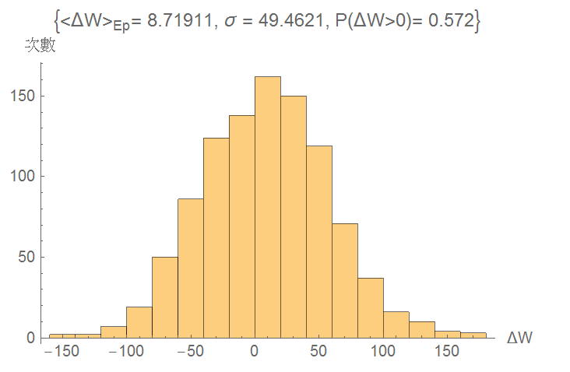
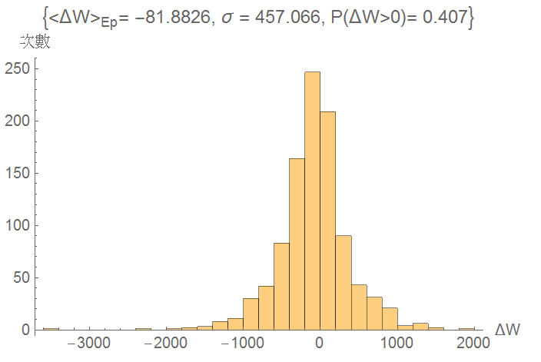
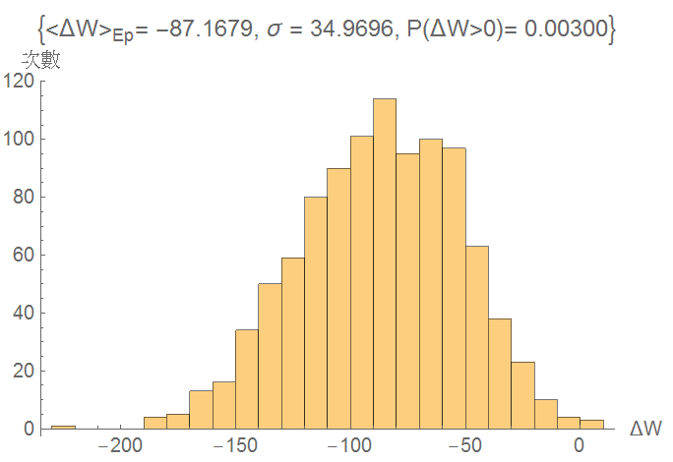
$2 & MG in MG-open system n1=1,n2=1,n3=99,m=2,s=2,T=399 1000 realization

